Slide 1
Fashion Retail Analysis
By:
Vista D Yulianti

Slide 2
Vista D Yulianti
Hello, my name is Vista. I am a Data Analyst specializing in the retail fashion industry, providing consultancy to help brands optimize their performance. In this portfolio, I would like to share an overview of my daily tasks and the insights I generate to support data-driven decisions.

Slide 3
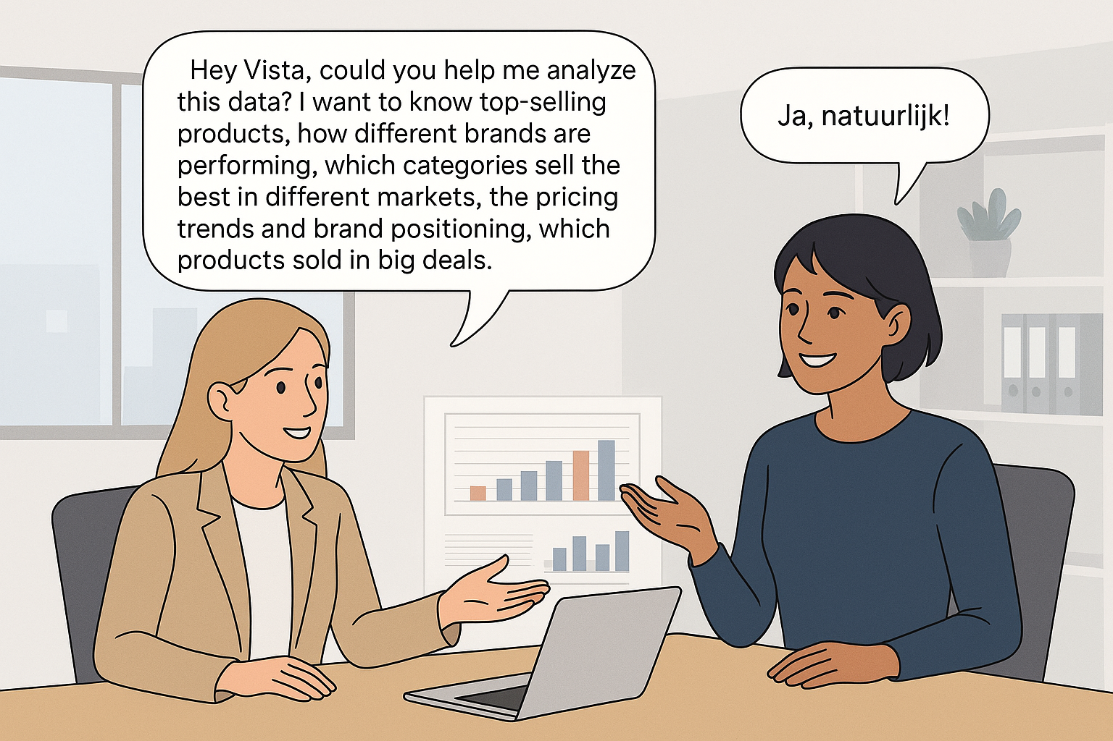
Notes:
Tim sales, Selia, come approach me and ask the data and analysis to solve this. She said Vista, can you help me to solve this problem. 1. Identify top-selling products
2. Compare how different brands are performing
3. See which categories sell the best in different markets
4. Check the pricing trends and brand positioning
5. Spot products sold in big deals
Then vista answer Ja, naturlijk.

Slide 4
Business Case Questions
Which products generated the highest total revenue in 2022?
What is the total sales amount by brand?
Which product types (Sneakers, T-shirts, Hoodies) are performing best in each country?
What is the average unit price per product type, and how does it vary by brand?
Which sales transactions contributed the most to total revenue per country?

Slide 5
Methods
Retail Fashion Data Analysis Workflow
Collect the Data – Sneakers and Streetwear Sales 2022 Dataset
Clean the Data using Python – Data Cleaning Notebook
Upload to Database (PostgreSQL) – Data Injection Notebook
Query the Database – Generate insights to answer business cases
Visualize in Power BI – Build interactive dashboards to support decision-making
Project Repository: Retail Fashion on GitHub

Slide 6
Tools
Python
SQL
Power BI

Slide 7
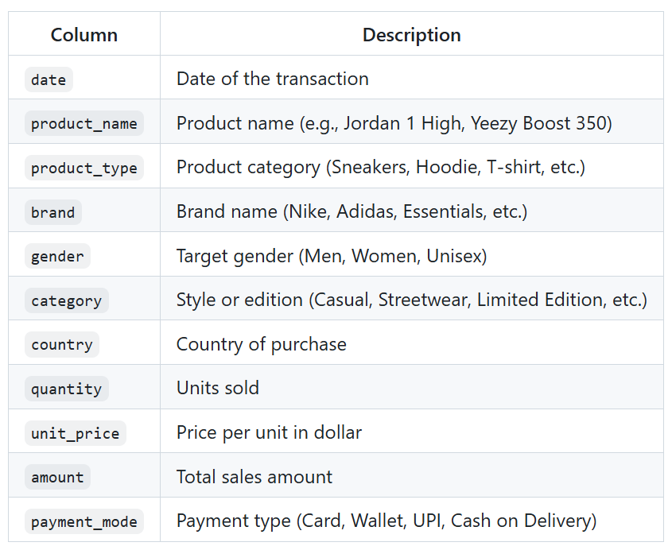
Data Description

Slide 8
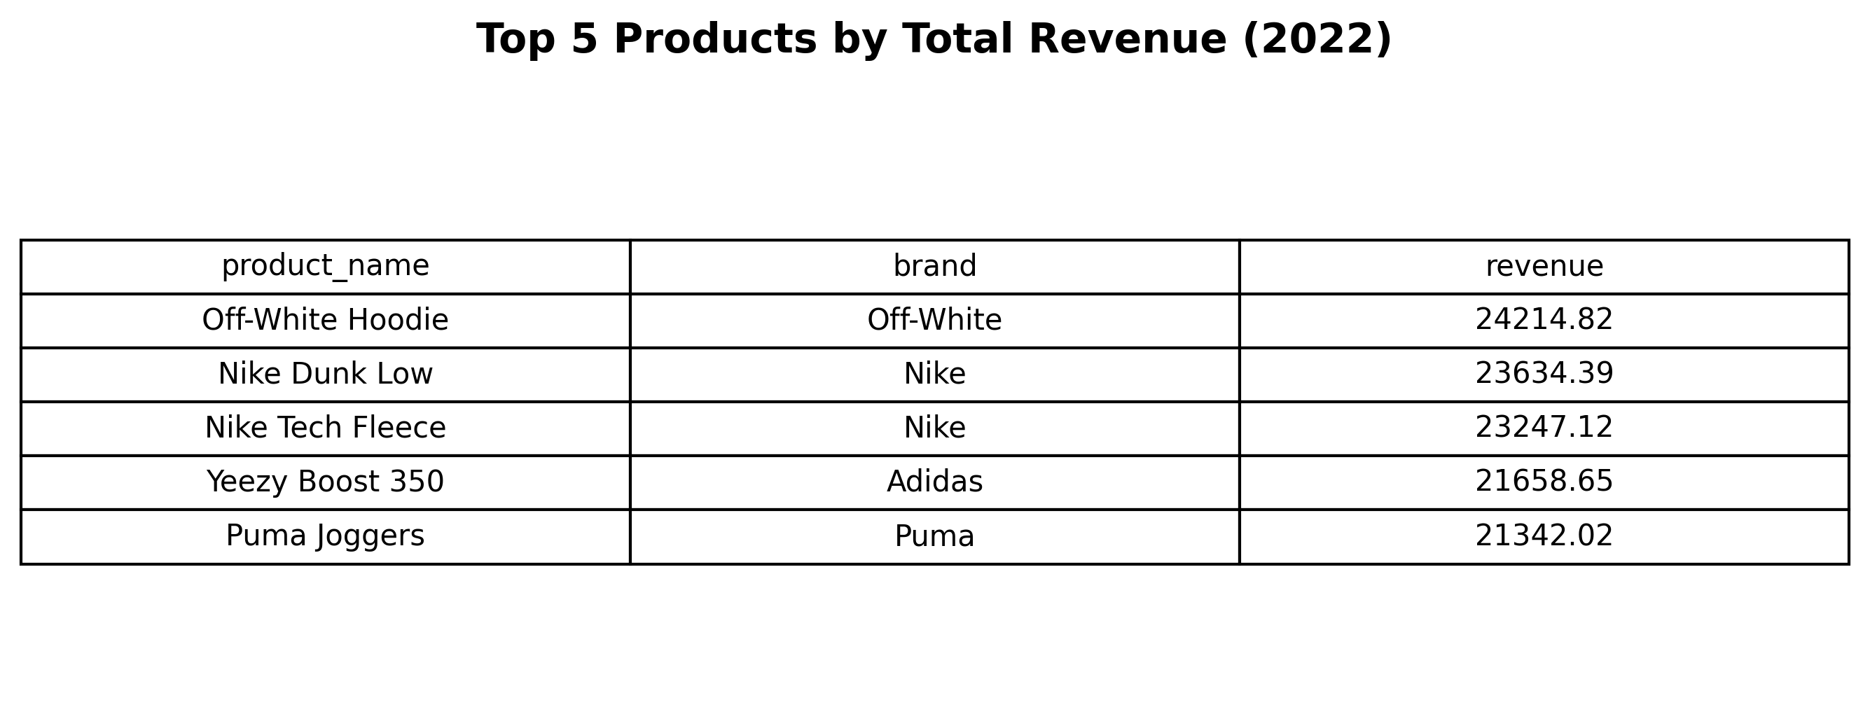
Result, Analysis, and Recommendation
1. Which products generated the highest total revenue in 2022?
SQL Code
select
product_name,
brand,
SUM(amount)::numeric(16,2) as revenue
from
sales_shoes
group by
product_name, brand
order by
revenue desc
limit 5;
The top five products generating the highest global sales in 2022 were the Off-White Hoodie, Nike Dunk Low, Nike Tech Fleece, Yeezy Boost 350, and Puma Joggers.
Recommendations: To increase revenue, the sales team should analyze the efforts already made for these top-performing products (including marketing, design, and promotions), so that successful strategies can be applied to other products to boost their sales.

Slide 9
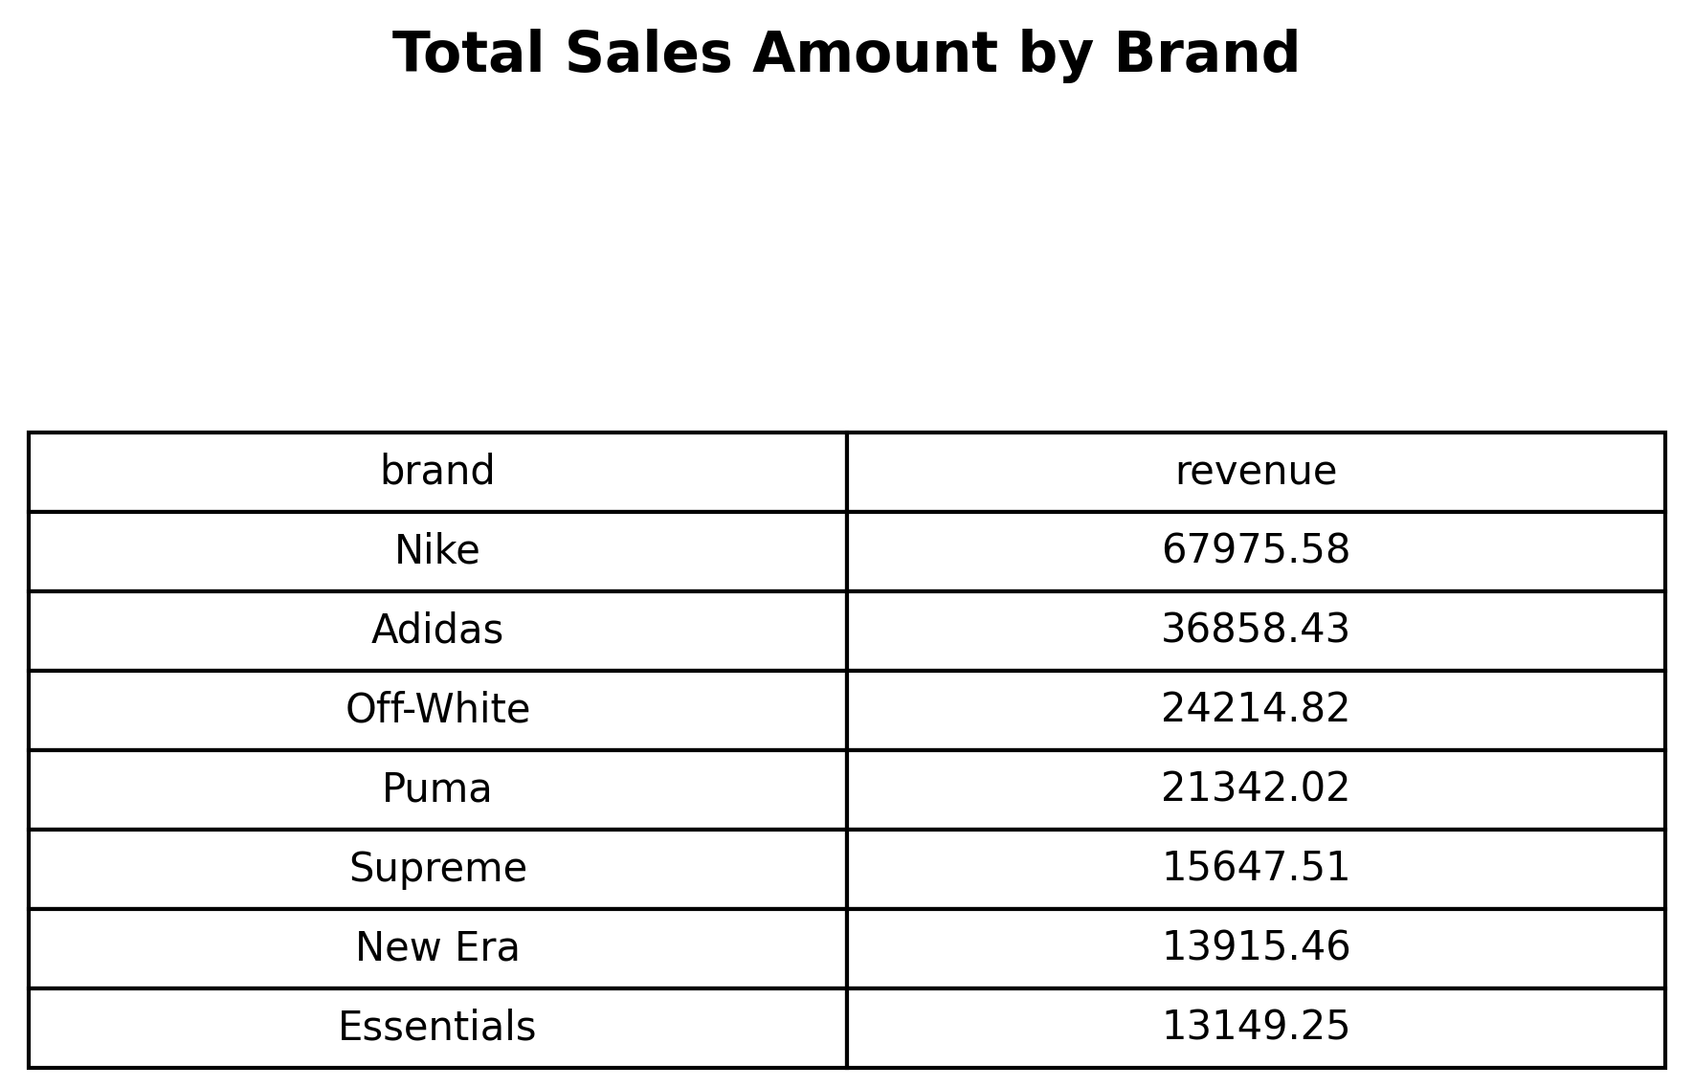
2. What is the total sales amount by brand?
SQL Code
select
brand,
SUM(amount):: numeric(16,2) as revenue
from
sales_shoes
group by
brand
order by
revenue desc;
Nike achieved the highest sales, reaching 67,975.58 USD, followed by Adidas, Off-White, Puma, Supreme, and New Era. Essentials recorded the lowest revenue, totaling 13,149.25 USD.
Recommendations:
Nike got the highest sales is probably due to the brand reputation and effective marketing. In order to increase the revenue from other brands, they can copy what Nike do in marketing campaigns, collaboration, and product design. Awareness to the brand is also the key to increase the revenue.

Slide 10
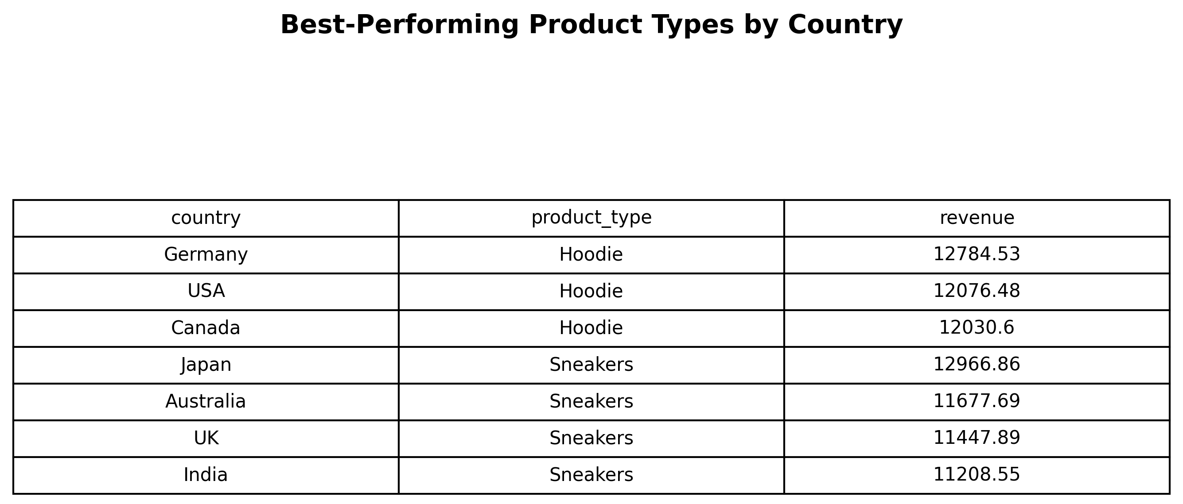
3. Which product types (Sneakers, T-shirts, Hoodies) are performing best in each country?
with revenue_product_type as(
select
country,
product_type,
sum (amount) as revenue
from sales_shoes
group by
product_type,
country
),
rank_revenue as (
select
*,
row_number() over(partition by country order by revenue desc) as sales_rank
from
revenue_product_type
)
select
country,
product_type,
revenue::numeric(16,2)
from
rank_revenue where sales_rank = 1
order by
product_type, revenue desc;
Sneakers generated the highest revenue in Australia, India, Japan, and the UK, while hoodies were the top-selling product type in Canada, Germany, and the USA.
Recommendations:
Brands should have a clear strategy for their product offerings. In markets where sneakers lead, the focus should be on limited editions, collaborations, and marketing campaigns. In hoodie-driven markets, emphasis should be on comfort and style, as well as seasonal promotions, since sales are often affected by the season.

Slide 11
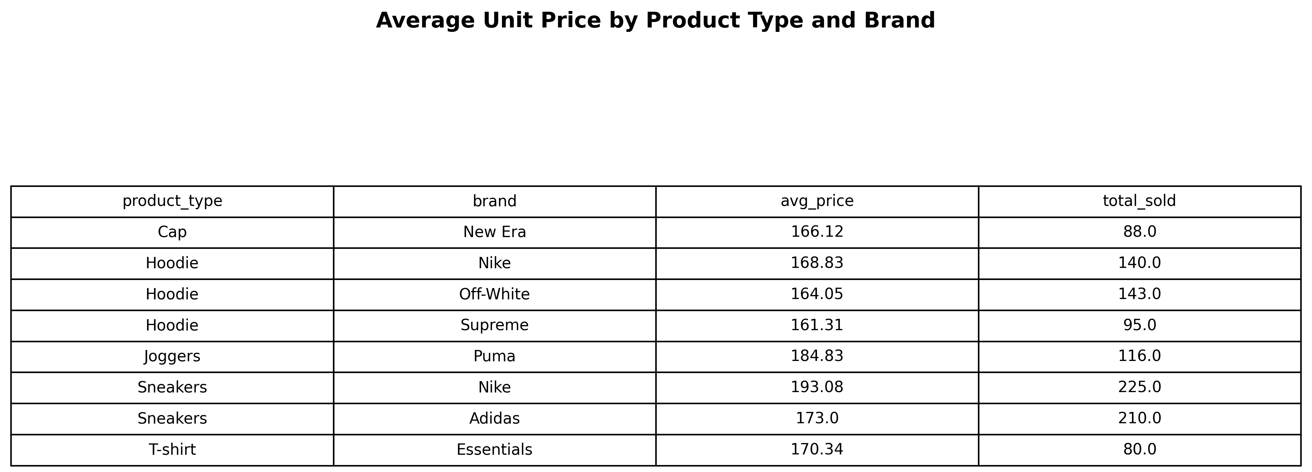
4. What is the average unit price per product type, and how does it vary by brand?
select
product_type,
brand,
avg (unit_price):: numeric(16,2) as avg_price,
sum (quantity) as total_sold
from
sales_shoes
group by
product_type, brand
order by
product_type, avg_price desc;
The cap product type is exclusive to New Era, joggers to Puma, and t-shirts to Essentials, so there is no comparison of average price with other brands. For hoodies, the highest average price is from Nike (168.83 USD), followed by Off-White (164.05 USD) and Supreme (161.31 USD). For sneakers, Nike also leads with an average price of 193.08 USD, followed by Adidas at 173.00 USD. Despite the higher prices, these products also achieve higher sales volumes.
Recommendations:
Customers are not very sensitive to product prices, which may be driven by exclusivity, brand loyalty, brand awareness, and perceived quality. To increase sales for other brands, they should emphasize the strengths of their products, such as offering lower prices without compromising quality. Alternatively, targeting different niche markets can create more segmented offerings, which can help boost sales.
Notes:
Which sales transactions contributed the most to total revenue?

Slide 12
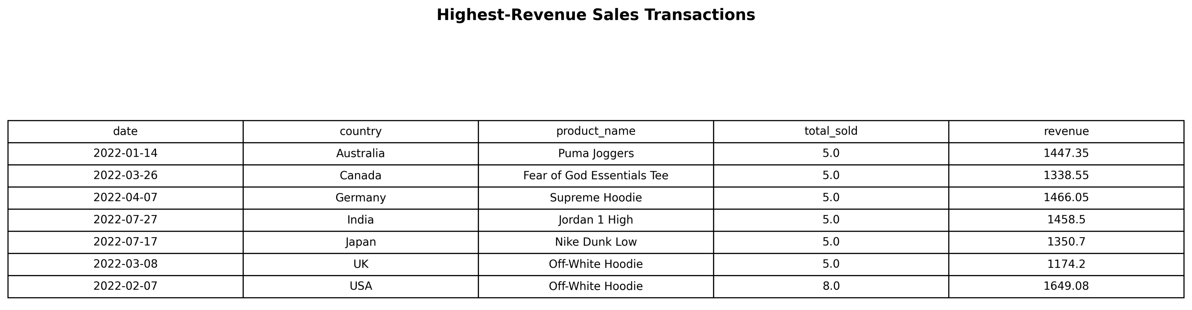
5. Which sales transactions contributed the most to total revenue per country?
SQL Code
with revenue_payment as (
select
date,
country,
product_name,
sum (quantity) as total_sold,
sum (amount) as revenue,
row_number () over (partition by country order by sum(amount) desc) as rank_transaction
from
sales_shoes
group by
date, country,product_name
)
select
date,
country,
product_name,
total_sold,
revenue::numeric(16,2)
from
revenue_payment
where
rank_transaction = 1;
This query identifies which products are ordered in bulk in each country. In Australia, the product ordered more than one piece is Puma Joggers. In Canada, it is Fear of God Essentials Tee. In Germany, it is Supreme Hoodie. In India, it is Jordan 1 High. In Japan, it is Nike Dunk Low. Meanwhile, in the UK and USA, it is Off-White Hoodie.
Recommendations:
This product list can be used to create promotions for business-to-business purposes. In this case, the bulk order is only five pieces, but in real situations, the volume is higher. In addition, it can also be used to design bundling promotions, which can further increase the revenue.
Notes:
The detail transaction can lead to business to business because they buy in bulk

Slide 13
Conclusion
The analysis highlights that brand reputation, marketing strategies, and product exclusivity are key drivers of sales performance.
Nike’s consistent leadership across categories demonstrates the impact of strong brand awareness and customer loyalty.
Regional differences in product preferences indicate the need for market-specific strategies to maximize sales potential.
Customer purchasing decisions are influenced more by quality and exclusivity than by price sensitivity.
Bulk orders and B2B opportunities present valuable potential to boost revenue through strategic partnerships and bundling promotions.

Slide 14
Power BI

Slide 15
Study Case
Other departments also asked me to answer their business case question. This query and result can be seen in the following link:

